Slide 1
The Dimensions of happiness
Authored by:
Jenn Brockman, Soumya murali, heather barker, Sebastian Munoz, and Chris Elliott

Slide 2
World Happiness report
The World Happiness Report is a landmark survey of the state of global happiness. was released at the United Nations at an event celebrating International Day of Happiness on March 20th. The report continues to gain global recognition as governments, organizations and civil society increasingly use happiness indicators to inform their policy-making decisions. Leading experts across fields – economics, psychology, survey analysis, national statistics, health, public policy and more – describe how measurements of well-being can be used effectively to assess the progress of nations. The reports review the state of happiness in the world today and show how the new science of happiness explains personal and national variations in happiness.
Our project – hap-py
Our project focused on why are countries happy? What types of things do they have in common, if anything?

Slide 3
HEATHER

Slide 4
Country Statistics - UNData
The United Nations Statistics Division (UNSD) of the Department of Economic and Social Affairs (DESA) launched a new internet based data service for the global user community. It brings UN statistical databases within easy reach of users through a single entry point (http://data.un.org/). This dataset contains key statistical indicators of the countries. It covers 4 major sections
General Information
Economic Indicators
Social Indicators
Environmental & Infrastructure Indicators

Slide 5
Urban Population does have an effect on the happiness of countries, the more urban areas a country has the happier the population seems.
Population using improved drinking water facilities makes countries happier.

Slide 6
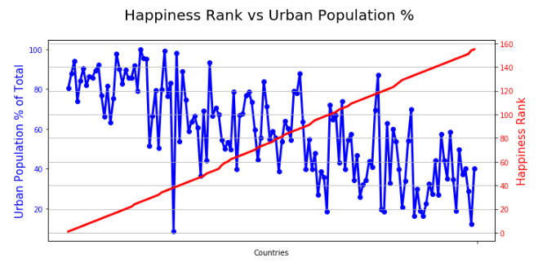
Urban populations tend to be happier
In the top 20 happiest countries the urban population is 83% of the total, while in the bottom 20 it only makes up 34%.

Slide 7
Urban populations outliers
Trinidad and Tobago, are the lower point on the Urban Population chart, they are the 38th happiest country with only 8.4% Urban Population

Slide 8
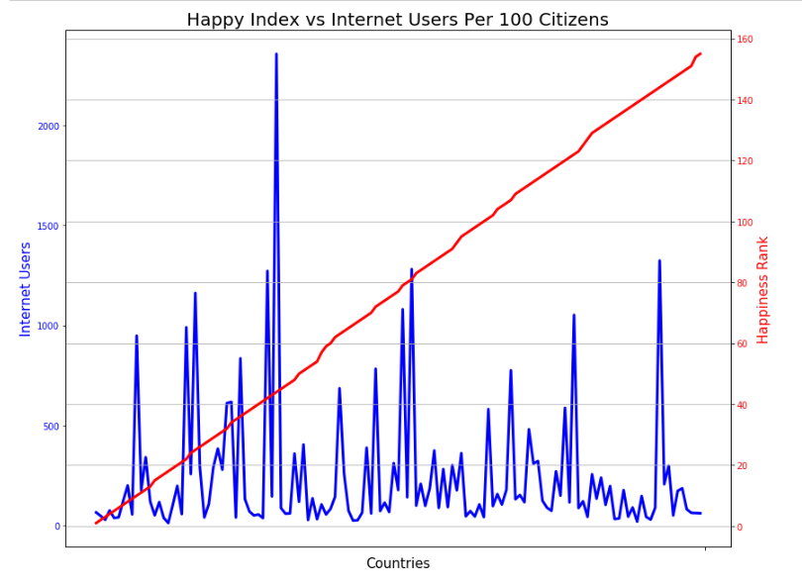

Slide 9
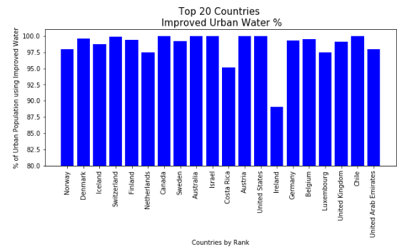
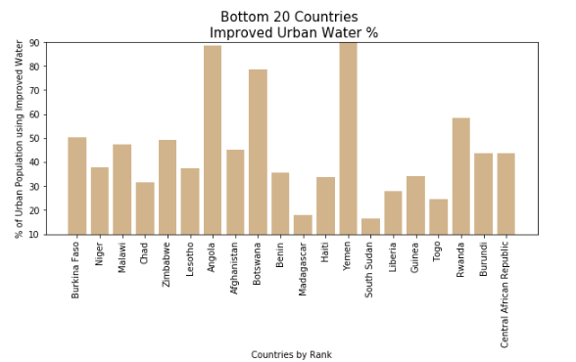
Countries with improved drinking water facilities tend to be happier
The top 20 happiest countries the population using improved drinking water facilities was an
% while the bottom 20 was only 44.7%

Slide 10
HEATHER reflection

Slide 11
Michelin Restaurants

Slide 12
Do Michelin Restaurants increase the happiness in a country?

Slide 13
Where did I find the data and why did I use it?
I pulled the data from Kaggle.
It had a 9.4 in usability.
The data was separated mostly by countries which was what I needed to compare it to the happiness data.

Slide 14
Analysis Process:
First, I had to clean the data and remove columns that I would not need which included restaurant names , zip codes and a few other columns for both the happiness and restaurant data. Some of the countries were broken down by states or provinces so I had to combine a few of the rows so that they were with the corresponding countries.
Then came the merging, the Michelin restaurant data was divided up by three csv files by star quantity, so I had to combine them so I get the total restaurant count for each country I then merged the Michelin data with the Happiness data.

Slide 15
Analysis process cont’d.
Once the two data sets were merged, I checked for duplicates, there were none, but some of the rows had NaN’s so I used .fillna(0) to convert them to zero.
I then took the merged data and created two different data frames, one for the top 20 happiest countries and the other for the lowest 20 happiest countries.
Finally I plotted the data, I used bar graphs and a scatter plot as they best showed the data.

Slide 16

2018 Top 20 happiest countries and Michelin restaurant totals bar graph

Slide 17
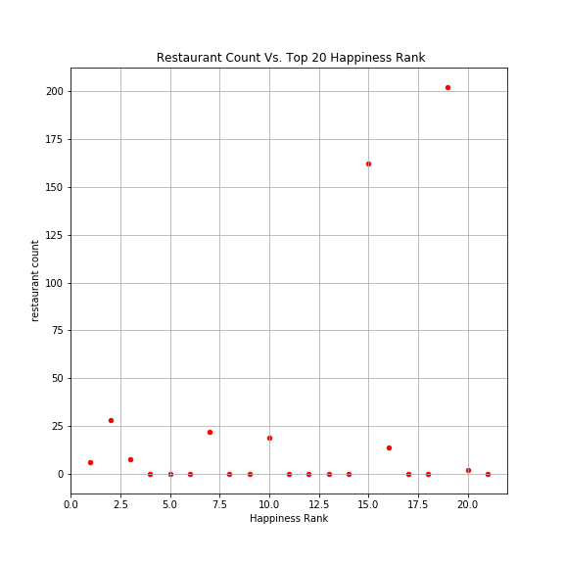
2018 Top 20 happiest countries Vs. Michelin restaurant totals bar graph

Slide 18
Observation:
There was no real correlation between happiness and total Michelin Restaurants, however there was a correlation between Super Power countries (US,UK) and high Michelin restaurant totals.
A little over half of the countries have no Michelin Restaurants

Slide 19

2018 lowest 20 happiest countries and Michelin restaurant totals bar graph

Slide 20
Observation:
The 20 countries with the lowest happiness ranks have no Michelin restaurants.

Slide 21
Conclusion:
There was no real correlation between the top 20 happiest countries and their Michelin restaurant counts. However there was correlation between the 20 countries with the lowest happiness rank and Michelin restaurant counts, where the saddest countries don’t have any Michelin restaurants. Inconclusion while Michelin restaurants can't guarantee high happiness, it could increase it slightly.

